Slide 1


Analysis of EPL 2020-2021 Season: Player Performance and Insights
Exploring Match Experience and Age for Player Comparisons

Slide 2
Introduction : What Does the Data Show?
Insights : Based on this data, you can see pairs of players from different clubs who have similar levels of match experience (matches played) and are approximately the same age. This information can be useful for various purposes, such as scouting, player comparison, or analyzing player performance across different clubs in the EPL.
Content:
Analysis focuses on players from different clubs with:
Similar levels of match experience (matches played).
Comparable ages.
Highlights potential for:
Scouting opportunities.
Player comparisons.
Cross-club performance analysis.

Slide 3
Insights from New Metrics
Content:
MinsPerMatch :
Measures the average number of minutes a player spends on the field per match.
Highlights players' on-field contribution time.
Useful for comparing players with varying game times.
GoalsPerMatch :
Measures the average number of goals scored by a player per match.
Identifies high-scoring efficiency players.
Useful for spotting consistent goal scorers.
These metrics offer a standardized way to compare players across different playing conditions.

Slide 4
There are some players who can play multiple positions but I have only taken their main position for convenient analysis.
This code applies a function to each value, splitting the string at the first comma and returning the part before comma.
Some players who play in multiple positions are assigned their primary (first-listed) position.

Slide 5

TOTAL GOALS FOR an EPL SEASON (excluding own goals)
1040 GOALS (2.82 per match) ------------ 2018-19
1002 GOALS (2.72 per match) ------------ 2019-20
1037 GOALS (2.82 per match) ------------ 2021-22
1041 GOALS (2.85 per match) ------------ 2022-23
source (https://www.premierleague.com/stats/records)
Insights :The 20-21 season had less goals scored by the players compared to other season.

Slide 6
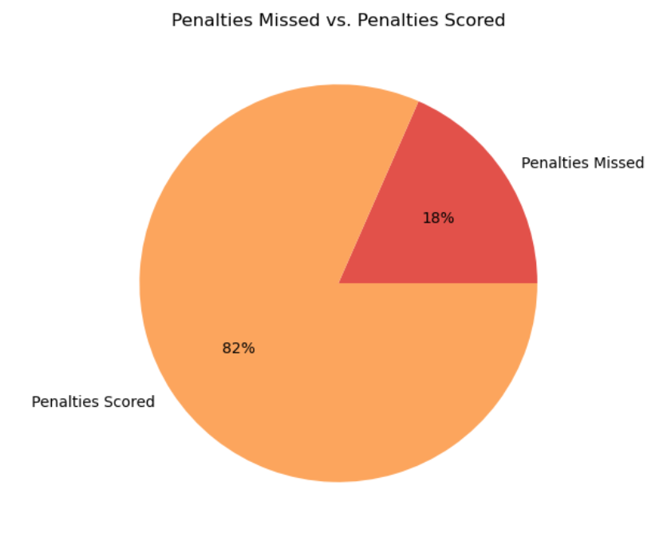
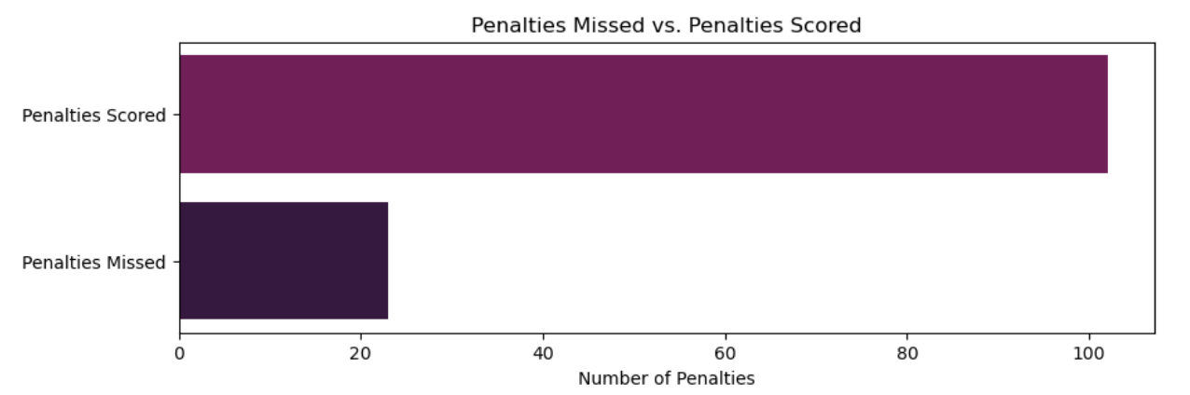
How successful are players in converting penalty attempts into goals? Pie Chart Bar Chart

Slide 7
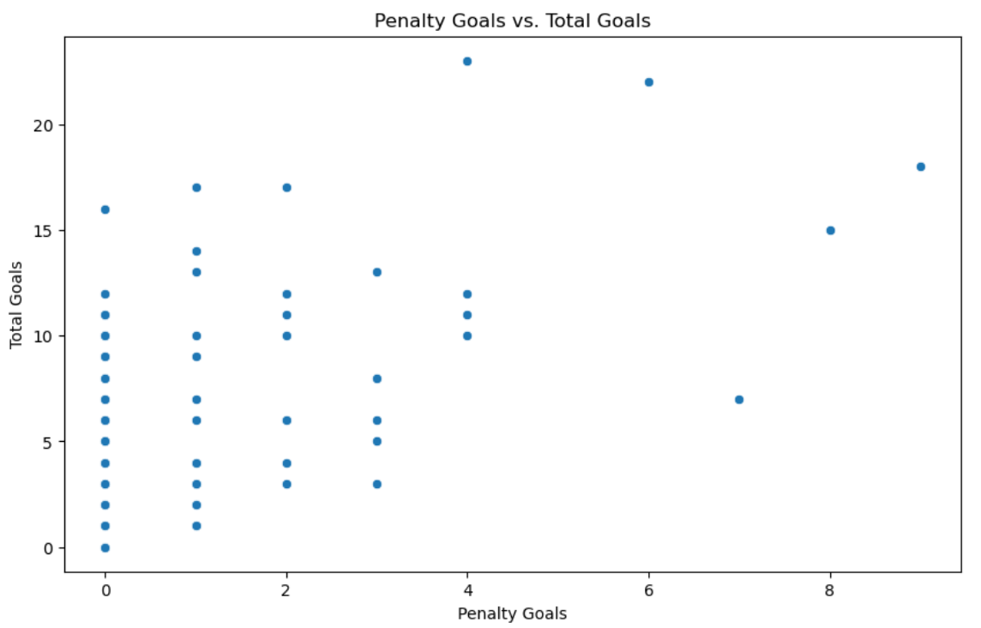
Is there a correlation between penalties awarded and the number of goals a player scores?
A correlation of 0.59 means there’s a moderate link between penalty goals and total goals—players who score more penalty goals tend to score more total goals. However, this doesn’t mean penalty goals directly cause more total goals, as other factors also play a role.

Slide 8
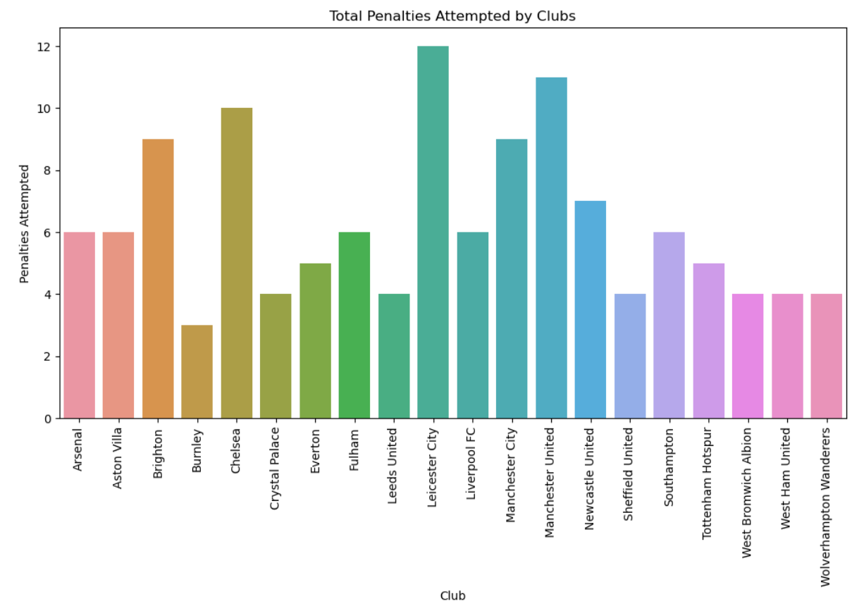
Which club attempted the most penalties?
CONCLUSION: Leicester city attempted the most penalties, while Burnley attempted the least penalties.

Slide 9
Position (cards)
Yellow Cards: The positions of "MF" and "DF" tend to have the highest average number of yellow cards. This is indicated by the taller and wider portions of the violin plots for these positions. Positions like "FW" and "GK" have relatively lower averages of yellow cards, as suggested by the narrower parts of their respective violin plots.
Red Cards: The distribution of red cards appears to be less common across all positions, as indicated by the thinner and shorter violin plots compared to yellow cards."MF" and "MF" still tend to have a slightly higher average number of red cards, but this is relatively low overall.

Slide 10
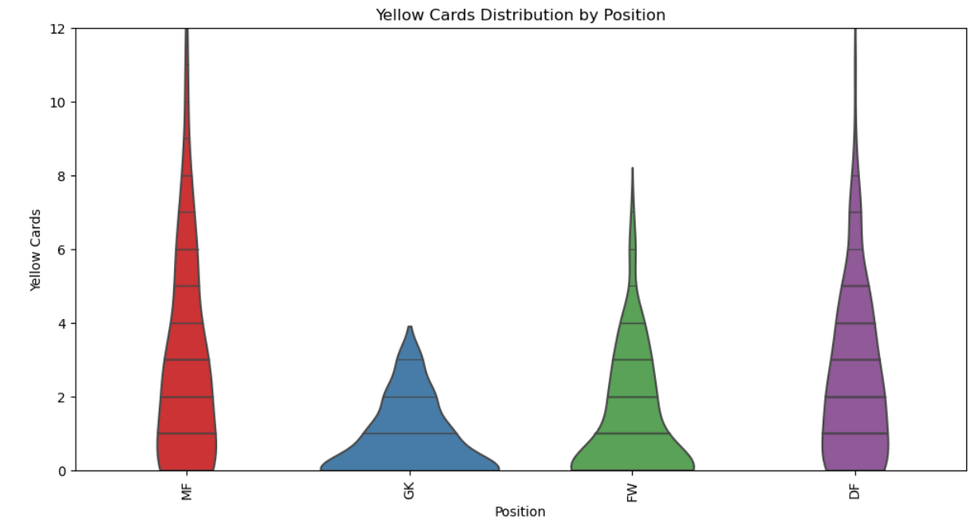
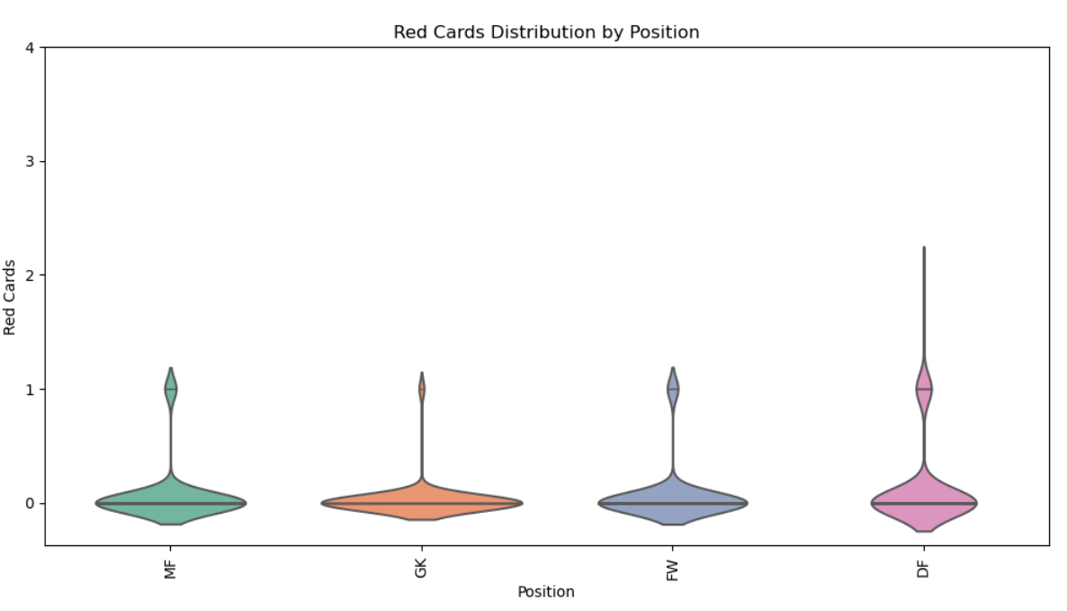
Yellow Card and Red Card

Slide 11
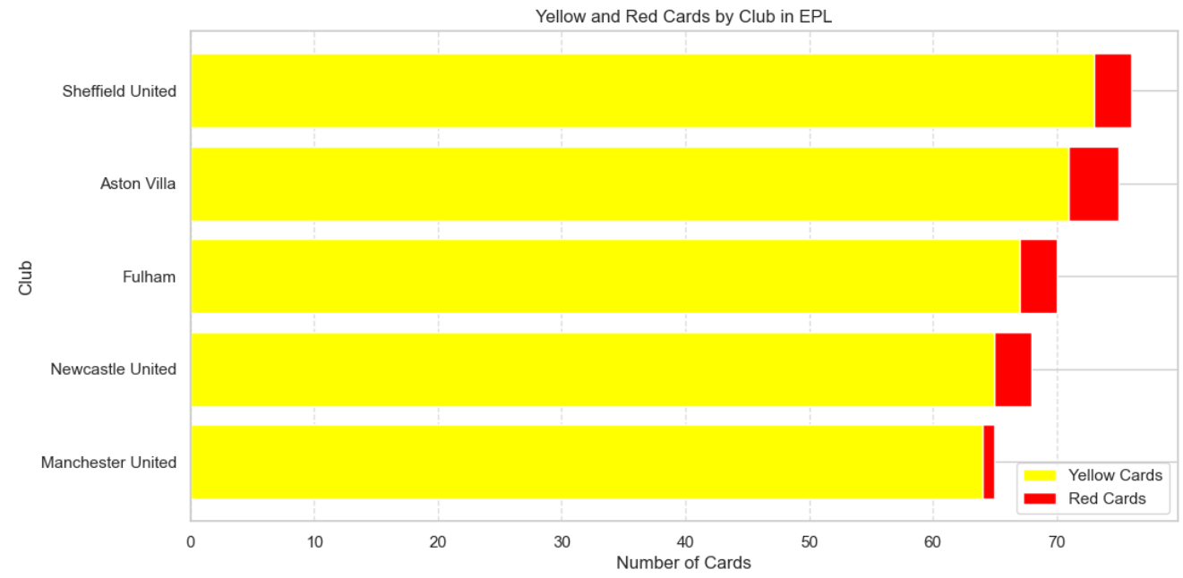
Top 5 Club in EPL who got more cards

Slide 12
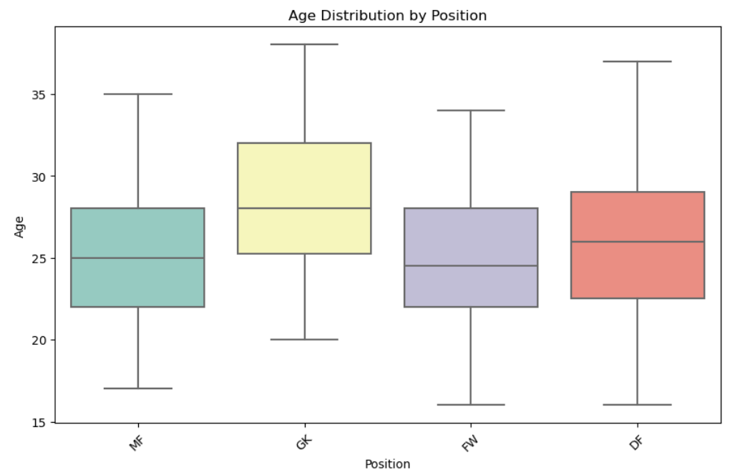
What is the average age of players according to their position ?
The box plot shows that positions like "GK" tend to have older players on average compared to other positions, while positions like "FW" have a wider range of ages with some younger players.

Slide 13
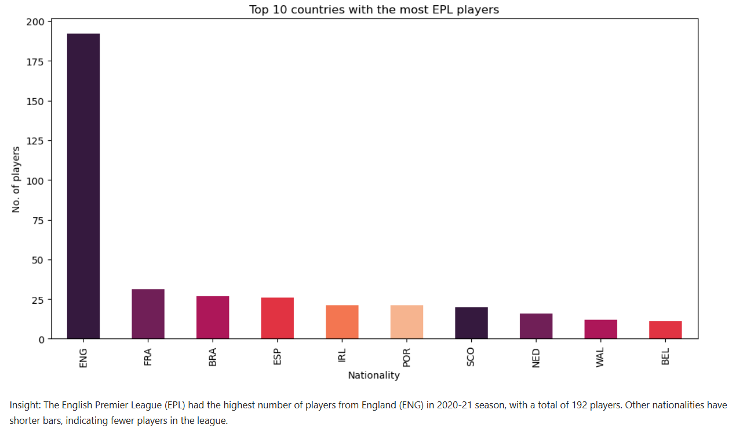
Top 10 countries with the most EPL players

Slide 14
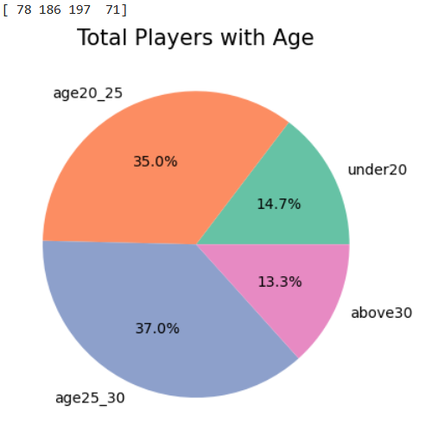
Total players with Age
Insights: The group of players aged 26-30 is the largest, with 197 players, making up approximately 37% of the total. The group of players aged 21-25 comes next, with 25 players, constituting about 35%.The group of players aged over 30 is the third largest, with 71 players, accounting for roughly 13.3%.The group of players aged 20 or younger is the smallest, with 78 players, making up approximately 14.7% of the total."

Slide 15
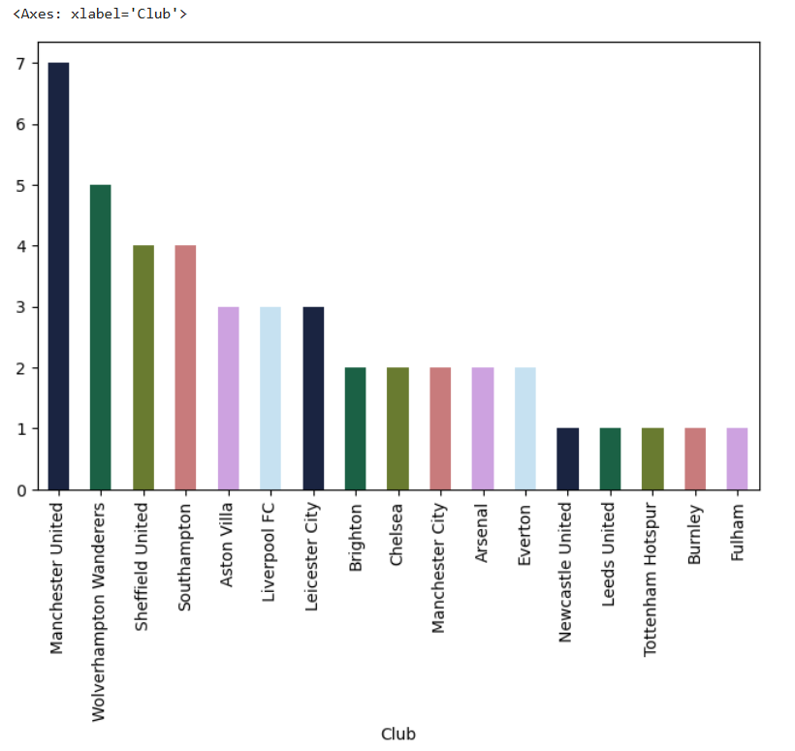
Total under 20 player in each club

Slide 16
How are the Expected Goals (xG) and Expected Assists (xA) distributed among the players in the dataset?
Interpretation: In the histogram for xG, we see that the majority of players have relatively low xG values, indicating that they are less likely to score goals. There are a few players with higher xG values, suggesting that they are more likely to score. In the histogram for xA, we observe a similar pattern. Most players have low xA values, indicating a lower likelihood of providing assists. However, there are some players with higher xA values, suggesting a higher likelihood of creating goal-scoring opportunities for their teammates.

Slide 17
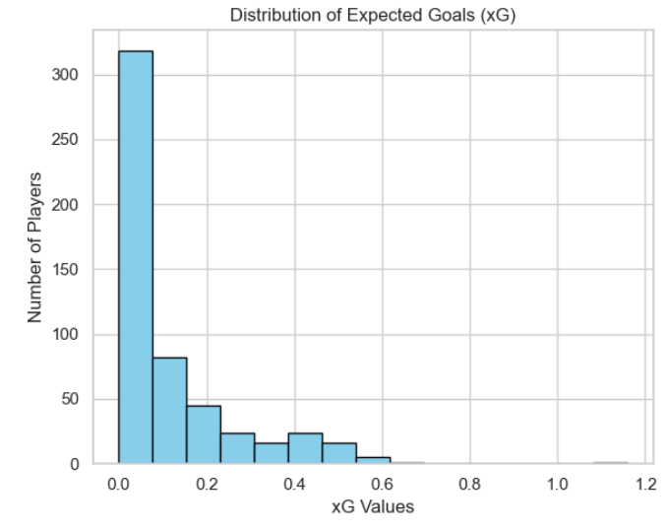
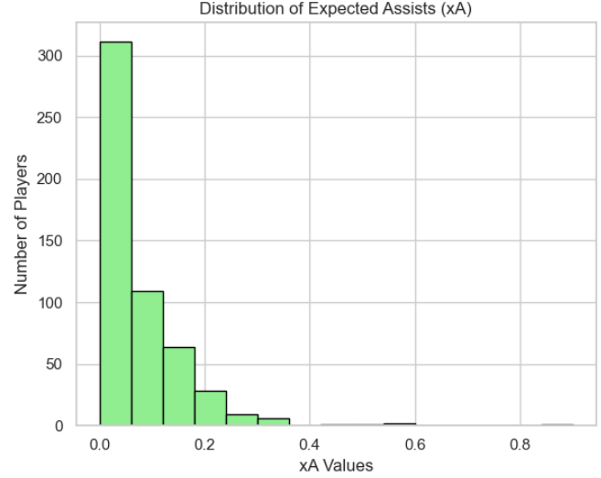
Expected Goals(xG) And Expected Assists(xA)

Slide 18
Conclusion:
In conclusion, the analysis of the dataset related to the English Premier League (EPL) for the 2020-2021 season has provided us with valuable insights into how footballers coped with the unique challenges posed by the COVID-19 pandemic. This season was marked by fanless stadiums, altered home advantage, and the mental and emotional impact on players. Here are some key takeaways from our analysis.
Performance Standouts: We identified standout performers based on metrics such as goals, assists, and minutes played. These players demonstrated their adaptability and resilience in the face of adversity.
Positional Influence: Our exploration of player positions revealed how different roles on the field correlated with individual performance and contributions to the team's success.
Club Variations: We compared player statistics across different EPL clubs, uncovering trends and variations that shed light on each club's unique playing style and strengths.
Age and Performance: The analysis of age and performance metrics helped us understand how player age influenced their contributions, highlighting the importance of experience and youth in the league.
Discipline: We examined the disciplinary records of players, identifying those with a high number of yellow and red cards. This analysis highlighted the importance of maintaining discipline on the field.
Passing Accuracy: Evaluating passing accuracy showed us how precise passing influenced team play and overall performance.
Expected Goals and Assists: The analysis of expected goals (xG) and expected assists (xA) allowed us to assess a player's ability to create scoring opportunities, providing insights into their playmaking skills.
Penalty Proficiency: Our examination of penalty goals and attempts revealed which players excelled in penalty situations, a critical aspect of the game.
By achieving these objectives, we have gained a deeper understanding of player performance in the EPL during a season unlike any other. This analysis showcases the adaptability and resilience of EPL players, who faced and overcame the challenges posed by the absence of fans and the unique circumstances of the 2020-2021 season. These insights contribute to our appreciation of the dedication and skill of the athletes who make the EPL one of the most exciting and competitive football leagues globally.

